Slide 1

IPL Match Winner Prediction
TEAM CRICGEEKS
1 | Kalki Bhavsar | AU1841029
2 | Harsh Mange | AU1841130
3 | Vardhan Shah | AU1841138
4 | Khushi Shah | AU1841139
Faculty: Mehul S Raval
Teaching Associate: Jay Patel, Arpit Patel
Notes:
Khushi

Slide 2
INTRODUCTION
T20 format is unpredictable.
Few Answers Lies in Data.
Data Collection from Web Scraping.
Clean the Dataset.
Model application on Dataset.
Notes:
As we see Cricket match in T20 format is unpredictable.
Answer and pattern Lies in Data itself.
We have collected data from scratch and further done processing to clean dataset.
Then we build model from and apply on dataset

Slide 3
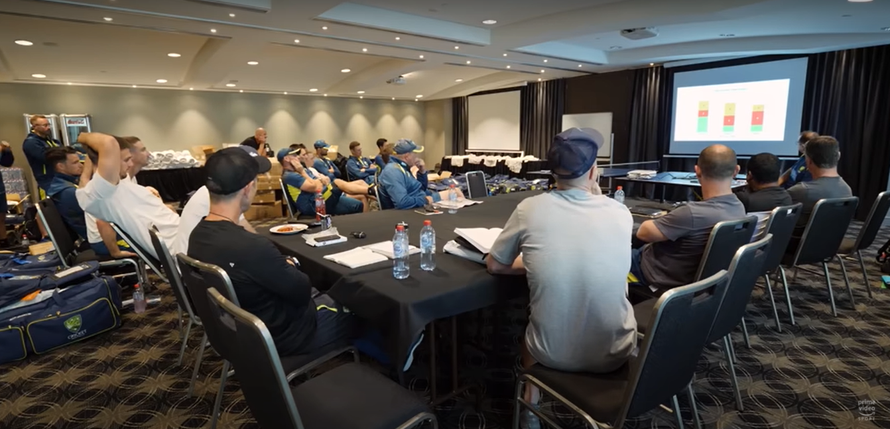
INTRODUCTION
T20 format is unpredictable.
Few Answers Lies in Data.
Data Collection from Web Scraping.
Clean the Dataset.
Model application on Dataset.

Slide 4
PROBLEM STATEMENT
Prediction of the winner of the IPL match based on the features like home-ground advantage, team-points, toss winner, pitch type, powerplay performance, etc.

Slide 5
EXISTING BODY OF WORK
To solve the problem statement,
Analysis the impact the features on the output variable winner [1].
Used basic five features like team1, team2, toss_winner, venue where SVM resulted highest accuracy upto only 66.23%. [2]
Used dataset of all the IPL matches starting from 2008 to 2020 with an additional feature of powerplay performance of both the teams. [3]
 | Logistic Regression | Random Forest Classifier | Gradient Boosting Classifier | Decision Tree Classifier | SVM | XGBoost Classifier
[2] | 61.59% | 55.63% | - | 62.25% | 66.23% | -
[3] | 70.5% | 64% | 72% | - | - | 74.18%

Slide 6
EXISTING BODY OF WORK
A Datasets is modelled based on performance of player on the field.
A multivariate regression based solution is suggested to calculate point of each player and then for whole team.
Explanation of Sigmoid Function, Cost function, Gradient Descent Function from [5].
Logistic Regression Hypothesis, Cost function and Advance optimization method explained[6].

Slide 7

OUR APPROACH
Scraping and understanding the dataset from the official ESPN, IPL website (Web-scraping)
Removing the redundancy inside the data values from manual checking (Data-cleaning)
Finding correlation matrix using
Pearson R Correlation to remove unnecessary columns (Feature Selection)
Step 1
Step 3
Step 5
Step 2 22
Step 4
Step 6
Reading the data-set and replacing the null values manually (Data-cleaning)
Encoding strings into categorical values + adding new derived columns (Feature Engineering)
Solve this classification problem using Logistic Regression (Building, Training and Testing the model)
Notes:
Kalki

Slide 8
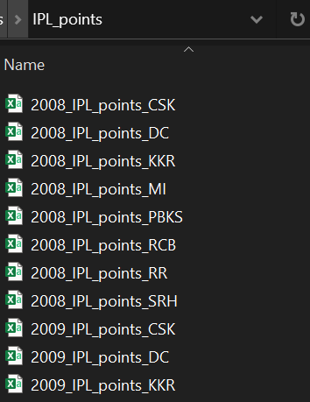
INITIAL RESULTS
Step 1
Web-scraping + Data Collection
For all the seasons 2008 to 2020, extracted the list of playing teams from dictionary "teams"
Using beautiful soup library, scraped the data under class-name found manually
Saved the scraped data into list named "columns"
Write the list "column" into the new file named "<season>_IPL_points_<team-name>" saved in the folder "IPL_points"
Notes:
HArsh
The data is the key to solve this problem. The data of following features id, season, city, date, team1, team2, toss winner, toss decision, result (normal or tie), DL applied, winner, win by runs, win by wickets player of match, venue, home ground advantage, umpire1, umpire2, umpire3, powerplay runs team1, powerplay wickets team1, powerplay runs team2, powerplay wickets team2, pitch type, form of player, etc. was scraped from the official ESPN and IPL website. The first step of data collection ends here.

Slide 9
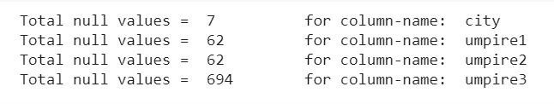
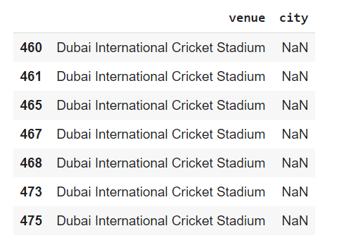
INITIAL RESULTS
Step 2
Data-cleaning
Check for Null Values
The data contains null values in 4 columns.
Drop the feature umpire1, umpire2, and umpire3 since there are lots of null values and these don’t have any impact on the winning team.
Insert values in the column ‘city’ where value is null based on the value of ‘venue’ column. Here, we replace NaN with “Dubai”.
Notes:
HArsh
In the next step, the data was cleaned. The data contained null values for the features like city, umpire1, umpire2, and umpire3. City could had null values where venue was ”Dubai International Cricket Stadium”. The null values were replaced by ”Dubai” for the column city. The features umpire1, umpire2, and umpire3 were dropped since the number of empty columns 62 for umpire1 and umpire2 while 694 for umpire3. The team names were renamed as mentioned in table I. Deccan Chargers (DC) was renamed to Sunrisers Hyderabad (SRH) in 2012 while Delhi Daredevils (DD) was renamed to Delhi Capitals (DC). Keeping this into account the renaming of teams was done. The next step was to remove redundancy in values. For example, ”Feroz Shah Kotla” and ”Feroz Shah Kotla Ground” are same venues in the same city Delhi. Also,

Slide 10
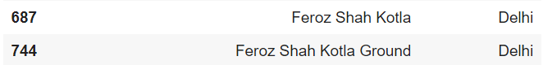
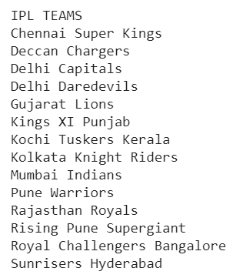
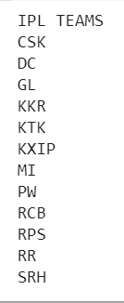
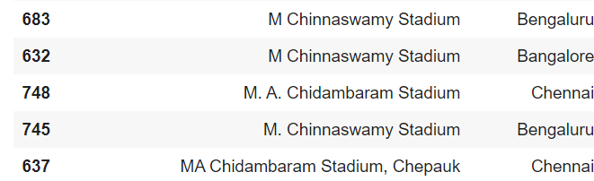
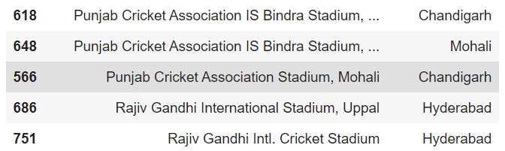
INITIAL RESULTS
Step 3
Data-cleaning
Renaming the team names
Deccan Chargers (DC) was renamed to Sunrisers Hyderabad (SRH) in 2012 [1]
Delhi Daredevils (DD) was renamed to Delhi Capitals (DC) [2]
2. Checking for the rows with
same venue, different venue names
Notes:
Harsh

Slide 11
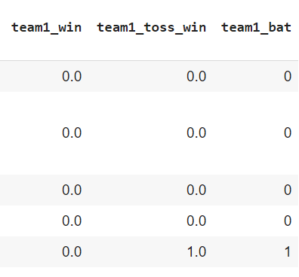
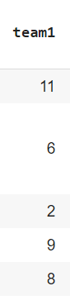
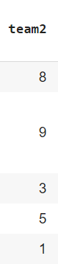
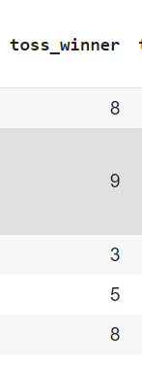
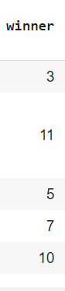
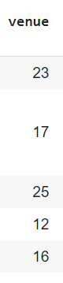
INITIAL RESULTS
Step 4
Feature Engineering
The column values should make some sense to the computers. Since the computer don’t have the ability to understand and draw inference from the text, we need to encode the strings to numeric categorical values. Encoding ways:
1. Manually: Adding new columns
2. Using LabelEncoder() from the Scikit-learn library
Notes:
KAlki
The next step is Feature Engineering. The column values should make some sense to the computers. Since the computer don’t have the ability to understand and draw inference from the text, we need to encode the strings to numeric categorical values. There are two encoding ways. First is manually and second is by using tools LabelEncoder() from the Scikitlearn library in PYTHON. The columns ”team1”, ”team2”, ”winner”, ”toss winner”, ”city”, and ”venue” were encoded using LabelEncoder() while the new columns team1 win, team1 toss win, and team1 bat were encoded using 1’s and 0’s manually. In addition to this, home ground advantage was encoded as +1 if the venue is the home-ground of
team1.
Similarly -1 was used to encode if the venue is the home-ground of team2. If both teams or none of them have home-ground advantage, 0 was used to encode the same. The columns team1 points and team2 points did not make much impact to the accuracy. But when the difference was used i/e team point difference that is equal to team1 points - team2 points, the accuracy was improved of 4:55 12:12%.
Adding the feature of the team strength was also worked upon.

Slide 12
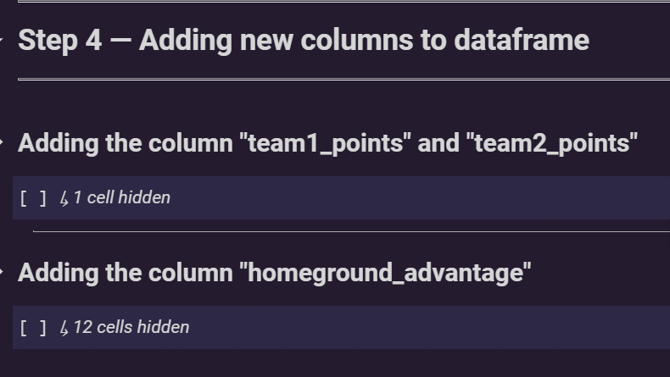
INITIAL RESULTS
Step 4
Feature Engineering
Adding new features:
Notes:
KAlki
The next step is Feature Engineering. The column values should make some sense to the computers. Since the computer don’t have the ability to understand and draw inference from the text, we need to encode the strings to numeric categorical values. There are two encoding ways. First is manually and second is by using tools LabelEncoder() from the Scikitlearn library in PYTHON. The columns ”team1”, ”team2”, ”winner”, ”toss winner”, ”city”, and ”venue” were encoded using LabelEncoder() while the new columns team1 win, team1 toss win, and team1 bat were encoded using 1’s and 0’s manually. In addition to this, home ground advantage was encoded as +1 if the venue is the home-ground of
team1.
Similarly -1 was used to encode if the venue is the home-ground of team2. If both teams or none of them have home-ground advantage, 0 was used to encode the same. The columns team1 points and team2 points did not make much impact to the accuracy. But when the difference was used i/e team point difference that is equal to team1 points - team2 points, the accuracy was improved of 4:55 12:12%.
Adding the feature of the team strength was also worked upon.

Slide 13
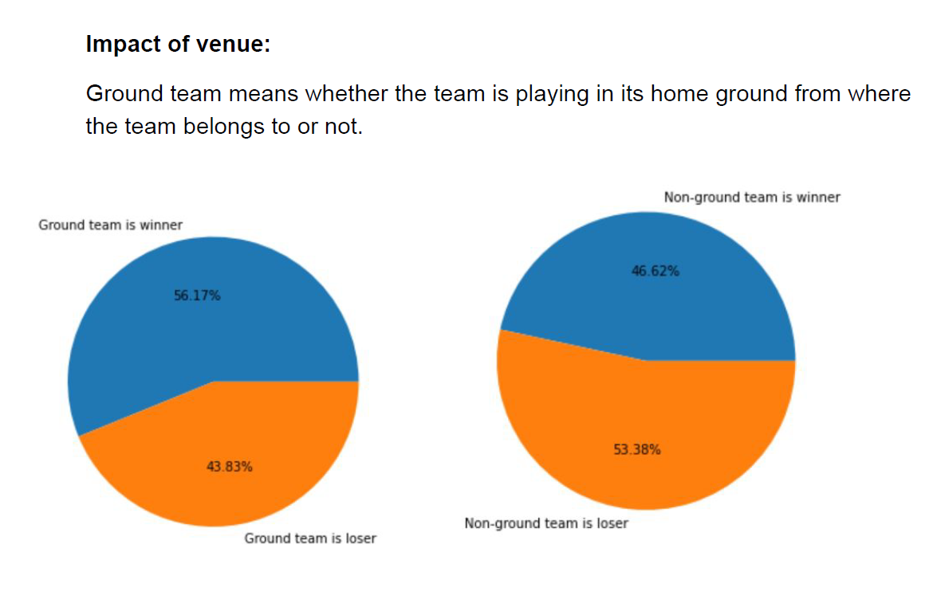
INITIAL RESULTS
Step 5
Feature Selection
Used Data Analysis and Visualization to check the impact of features on the target variable
Notes:
Kalki
In the feature selection step, few unnecessary and redundant
columns like season, date, id, play of match, etc were
removed. We found the correlation between two variables
using PEARSON R CORRELATION which is mostly used to
measure the degree of the relationship between linearly related
variables. When two variables are redundant, we decided a
threshold of 0.8 while removing the redundant features.

Slide 14
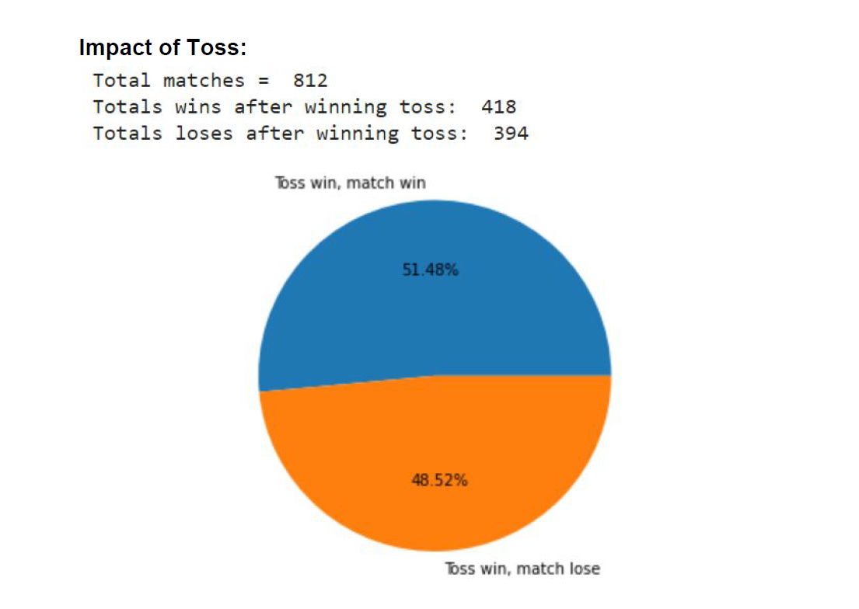
INITIAL RESULTS
Step 5
Feature Selection
Used Data Analysis and Visualization to check the impact of features on the target variable
Notes:
Kalki
In the feature selection step, few unnecessary and redundant
columns like season, date, id, play of match, etc were
removed. We found the correlation between two variables
using PEARSON R CORRELATION which is mostly used to
measure the degree of the relationship between linearly related
variables. When two variables are redundant, we decided a
threshold of 0.8 while removing the redundant features.

Slide 15
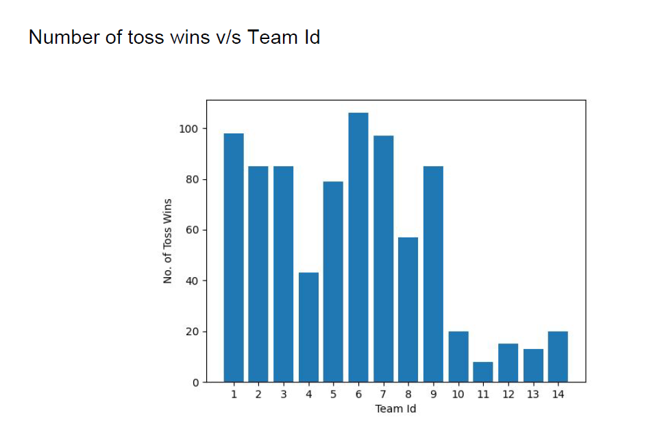
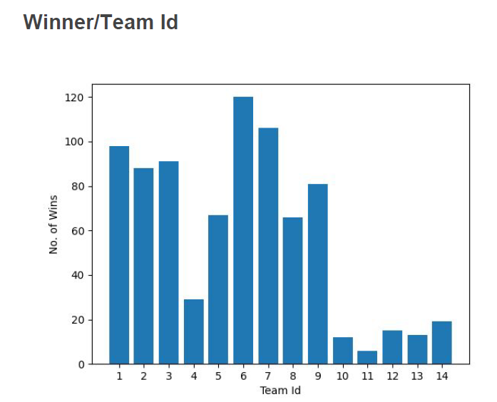
INITIAL RESULTS
Step 5
Feature Selection
Used Data Analysis and Visualization to check the impact of features on the target variable
(Here, Kolkata Knight Riders':1, 'Kings XI Punjab':2, 'Royal Challengers Bangalore':3, 'Deccan Chargers':4, 'Delhi Daredevils':5, 'Mumbai Indians':6, 'Chennai Super Kings': 7, 'Sunrisers Hyderabad':8, 'Rajasthan Royals':9, 'Pune Warriors':10)
Notes:
Kalki
In the feature selection step, few unnecessary and redundant
columns like season, date, id, play of match, etc were
removed. We found the correlation between two variables
using PEARSON R CORRELATION which is mostly used to
measure the degree of the relationship between linearly related
variables. When two variables are redundant, we decided a
threshold of 0.8 while removing the redundant features.

Slide 16
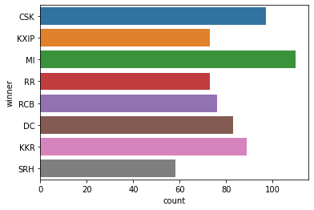
INITIAL RESULTS
Step 5
Feature Selection
Used Data Analysis and Visualization to check the impact of features on the target variable
Notes:
Kalki
In the feature selection step, few unnecessary and redundant
columns like season, date, id, play of match, etc were
removed. We found the correlation between two variables
using PEARSON R CORRELATION which is mostly used to
measure the degree of the relationship between linearly related
variables. When two variables are redundant, we decided a
threshold of 0.8 while removing the redundant features.

Slide 17
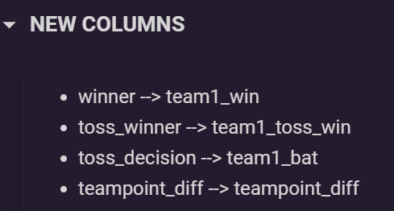
INITIAL RESULTS
Step 5
Feature Selection
In the feature selection step, few unnecessary and redundant columns like season, date, id, play_of_match, etc were removed.
New columns were added
Notes:
Kalki
In the feature selection step, few unnecessary and redundant
columns like season, date, id, play of match, etc were
removed. We found the correlation between two variables
using PEARSON R CORRELATION which is mostly used to
measure the degree of the relationship between linearly related
variables. When two variables are redundant, we decided a
threshold of 0.8 while removing the redundant features.

Slide 18
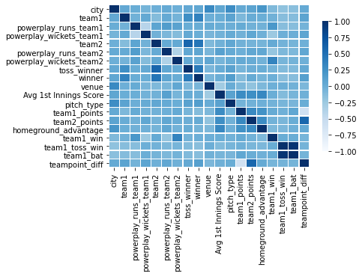
INITIAL RESULTS
Step 5
Feature Selection
In the feature selection step, few unnecessary and redundant columns like season, date, id, play_of_match, etc were removed.
We found the correlation between two variables
using PEARSON R CORRELATION which is mostly used to measure the degree of the relationship between linearly related variables.
When two variables are redundant, we decided a threshold of 0.8 while removing the redundant features.
Notes:
Kalki
In the feature selection step, few unnecessary and redundant
columns like season, date, id, play of match, etc were
removed. We found the correlation between two variables
using PEARSON R CORRELATION which is mostly used to
measure the degree of the relationship between linearly related
variables. When two variables are redundant, we decided a
threshold of 0.8 while removing the redundant features.

Slide 19
INITIAL RESULTS
Step
Model Building, Training, & Testing
The following algorithms were used :
 | Logistic Regression | Decision Tree Classifier | Support Vector Machine | Random Forest Classifier
Basic | 50% | 56.06% | 52.07% | 56.82%
+ Team1, 2 points | 61.36% | 56.27% | 59.85% | 60.61%
+Home-ground advantage | 60.61% | 50.76 | 59.85% | 60.61%
+ Points difference | 62.12% | 60.61% | 61.36% | 61.36%
The least performer outperformed when new important features were added
Notes:
Khushi:
Step 6 is model building ,training and testing.
Applied 4 basic algorithms. Logistic regression ,decision tree classifier, svm,random forest classifier and the accuracy is calculated for the data set.
The columns team1 points and team2 points did not make much impact to the accuracy. But when the difference was used i/e team point difference that is equal to team1 points - team2 points, the accuracy was improved of 4.55 ∼ 12.12%.
Logistic Regression outperformed other models like Decision Tree Classifier, SVM and Random Forest Regression when the new features like home ground advantage, teams’ point difference were added. Significant change in the accuracy was seen.

Slide 20
INITIAL RESULTS
Step 9
Model Building, Training, & Testing
Implemented Logistic Regression from Scratch
Included important features like ‘power play runs and wickets’ for both the team, ‘toss winner’, ‘home ground advantage’
Gradient Descent (loss minimization) has been used for the optimization of model
Overall accuracy increases significantly as no of iterations increases
Notes:
Khushi:
Step 6 is model building ,training and testing.
Applied 4 basic algorithms. Logistic regression ,decision tree classifier, svm,random forest classifier and the accuracy is calculated for the data set.
The columns team1 points and team2 points did not make much impact to the accuracy. But when the difference was used i/e team point difference that is equal to team1 points - team2 points, the accuracy was improved of 4.55 ∼ 12.12%.
Logistic Regression outperformed other models like Decision Tree Classifier, SVM and Random Forest Regression when the new features like home ground advantage, teams’ point difference were added. Significant change in the accuracy was seen.

Slide 21
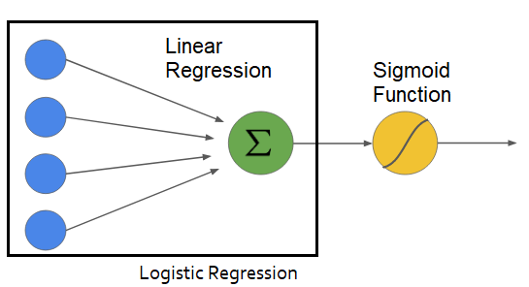
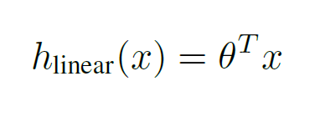
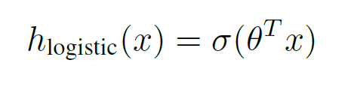
INITIAL RESULTS
Model
Logistic Regression
Notes:
Khushi:
Step 6 is model building ,training and testing.
Applied 4 basic algorithms. Logistic regression ,decision tree classifier, svm,random forest classifier and the accuracy is calculated for the data set.
The columns team1 points and team2 points did not make much impact to the accuracy. But when the difference was used i/e team point difference that is equal to team1 points - team2 points, the accuracy was improved of 4.55 ∼ 12.12%.
Logistic Regression outperformed other models like Decision Tree Classifier, SVM and Random Forest Regression when the new features like home ground advantage, teams’ point difference were added. Significant change in the accuracy was seen.

Slide 22
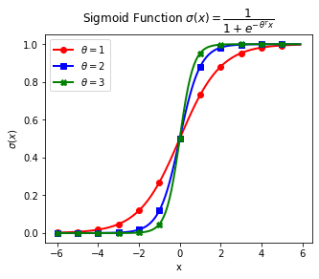
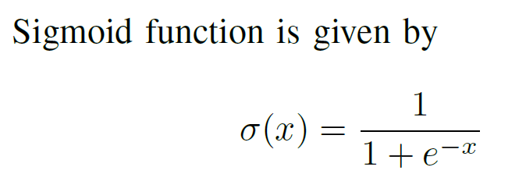
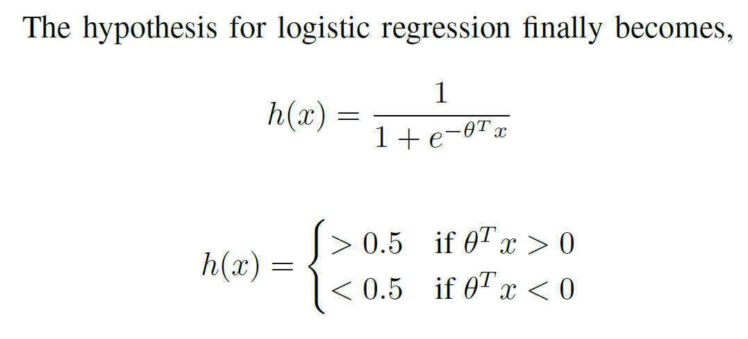
INITIAL RESULTS
Sigmoid Function
Notes:
Khushi:
Step 6 is model building ,training and testing.
Applied 4 basic algorithms. Logistic regression ,decision tree classifier, svm,random forest classifier and the accuracy is calculated for the data set.
The columns team1 points and team2 points did not make much impact to the accuracy. But when the difference was used i/e team point difference that is equal to team1 points - team2 points, the accuracy was improved of 4.55 ∼ 12.12%.
Logistic Regression outperformed other models like Decision Tree Classifier, SVM and Random Forest Regression when the new features like home ground advantage, teams’ point difference were added. Significant change in the accuracy was seen.

Slide 23
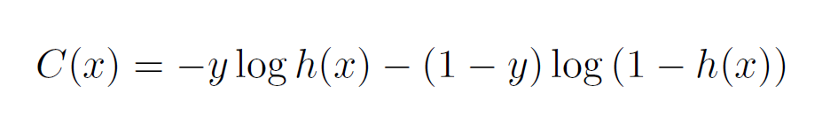
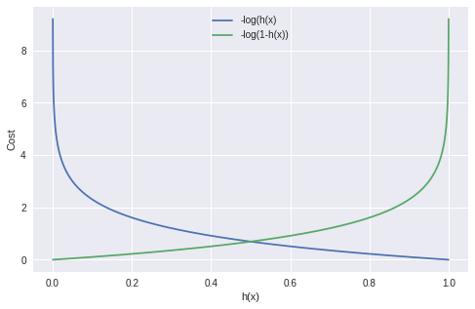
INITIAL RESULTS
Cost Function
Notes:
Khushi:
Step 6 is model building ,training and testing.
Applied 4 basic algorithms. Logistic regression ,decision tree classifier, svm,random forest classifier and the accuracy is calculated for the data set.
The columns team1 points and team2 points did not make much impact to the accuracy. But when the difference was used i/e team point difference that is equal to team1 points - team2 points, the accuracy was improved of 4.55 ∼ 12.12%.
Logistic Regression outperformed other models like Decision Tree Classifier, SVM and Random Forest Regression when the new features like home ground advantage, teams’ point difference were added. Significant change in the accuracy was seen.

Slide 24
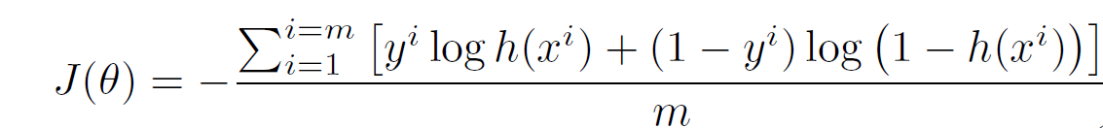
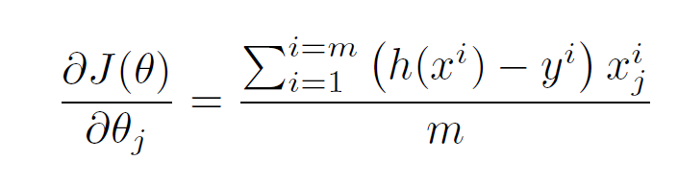
INITIAL RESULTS
Minimization Cost Function
The cost for all the training examples given m training examples
Minimizing the cost function using gradient descent:
Notes:
Khushi:
Step 6 is model building ,training and testing.
Applied 4 basic algorithms. Logistic regression ,decision tree classifier, svm,random forest classifier and the accuracy is calculated for the data set.
The columns team1 points and team2 points did not make much impact to the accuracy. But when the difference was used i/e team point difference that is equal to team1 points - team2 points, the accuracy was improved of 4.55 ∼ 12.12%.
Logistic Regression outperformed other models like Decision Tree Classifier, SVM and Random Forest Regression when the new features like home ground advantage, teams’ point difference were added. Significant change in the accuracy was seen.

Slide 25
INITIAL RESULTS
Step 9
Model Building, Training, & Testing
From Scratch |  |  |  |  |  | From inbuilt
Itr | LR = 0.001 | LR = 0.01 | LR = 0.1 | LR = 0.5 | LR = 1 | -
1500 | 67.15% | 59.77% | 59.77% | 60.14% | 59.77% | 69.37%
4000 | 67.52% | 63.83% | 63.83% | 64.20% | 64.20%
5000 | 67.52% | 64.57% | 64.57% | 64.20% | 63.46
Notes:
Khushi:
Step 6 is model building ,training and testing.
Applied 4 basic algorithms. Logistic regression ,decision tree classifier, svm,random forest classifier and the accuracy is calculated for the data set.
The columns team1 points and team2 points did not make much impact to the accuracy. But when the difference was used i/e team point difference that is equal to team1 points - team2 points, the accuracy was improved of 4.55 ∼ 12.12%.
Logistic Regression outperformed other models like Decision Tree Classifier, SVM and Random Forest Regression when the new features like home ground advantage, teams’ point difference were added. Significant change in the accuracy was seen.

Slide 26
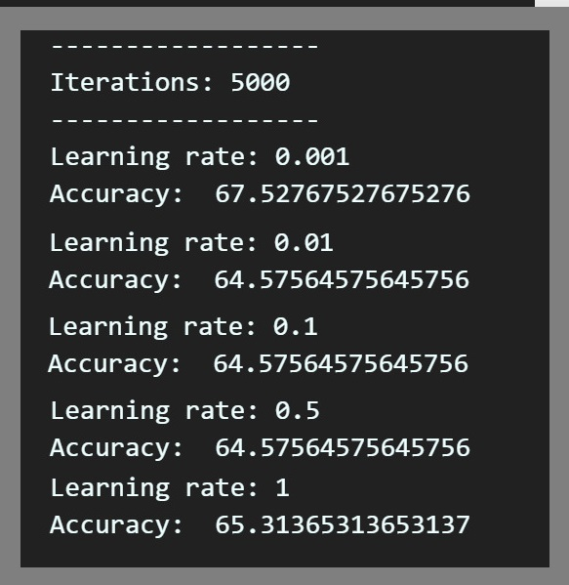
INITIAL RESULTS
Step 9
Results
Prediction is done after power play of the both teams(6 overs)
67.52% accuracy (best) has been achieved on 0.001 learning rate for 5000 iterations

Slide 27
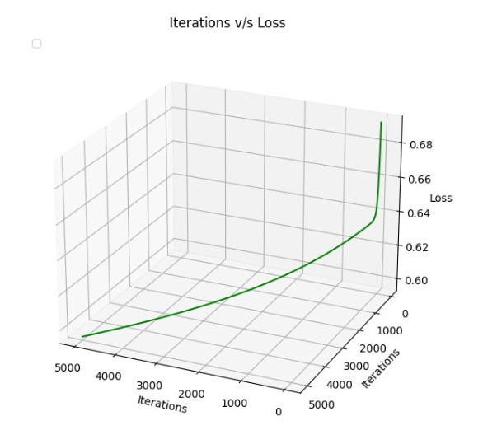
INITIAL RESULTS
Step 9
Results

Slide 28
WORK DISTRIBUTION
Dataset Gathering (or scrapping) Harsh
Merging & formation of dataset Kalki Harsh Vardhan
Literature review Khushi Kalki Vardhan
Conceptualizing dataset & sport Vardhan
Data Cleaning Kalki
Data visualization Kalki,Vardhan
Exploratory data analysis of selected features Kalki,Vardhan,Khushi
Feature importance (or weight) in terms of Output Harsh,Kalki
Feature engineering Kalki,Harsh
Feature selection & extraction Kalki,Vardhan,Khushi
Testing the dataset on various models Khushi,Harsh
Notes:
Vardhan Rajnikant Shah
This the overall work right from gathering dataset to to test dataset. which we had distributed among us and work uptill now.

Slide 29
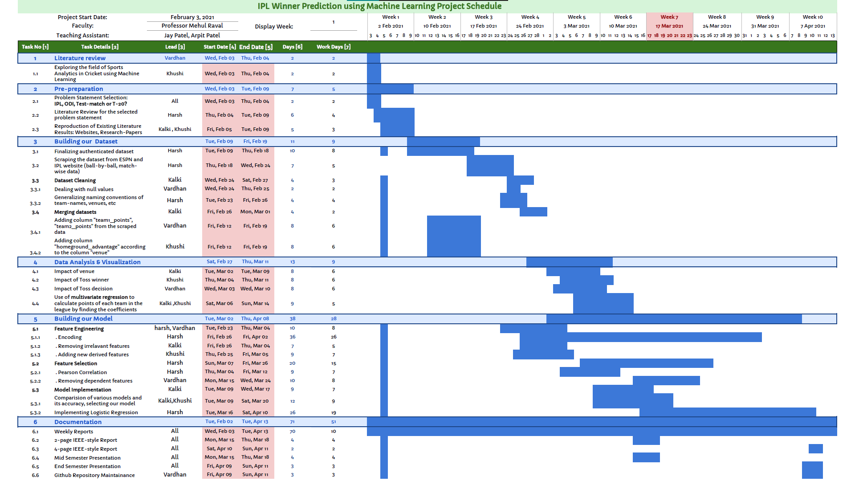

Slide 30
REFERENCES
Predictive Analysis of an IPL Match
Predicting outcome of IPL match based on variables
IPL Match Prediction based on Powerplay using Machine Learning
Predicting Outcome of IPL Matches Using ML
https://medium.com/@rgotesman1/learning-machine-learning-part-3-logistic-regression-94db47a94ea3
https://www.ritchieng.com/logistic-regression/
https://towardsdatascience.com/understanding-logistic-regression-using-a-simple-example-163de52ea900
Notes:
Vardhan - This are References which we refer during this project.

Slide 31
THANK YOU!
Notes:
Vardhan - Thank You

